Slide 1
Service Now Automation through Serenity
Serenity BDD (previously known as Thucydides) is an open source reporting library that helps you write better structured, more maintainable automated acceptance criteria, and also produces rich meaningful test reports (or "living documentation") that not only report on the test results, but also what features have been tested.

Slide 2
Advantages of Serenity Over Selenium WebDriver
Serenity BDD helps you write cleaner and more maintainable automated acceptance and regression tests faster.
Serenity also uses the test results to produce illustrated, narrative reports that document and describe what your application does and how it works.
Serenity tells you not only what tests have been executed, but more importantly, what requirements have been tested.
No Separate Logging is to be done and implemented in framework.
One key advantage of using Serenity BDD is that you do not have to invest time in building and maintaining your own automation framework.
You can work with Behavior-Driven-Development tools like Cucumber or JBehave, or simply use JUnit.
Beautiful Reports are generated by Serenity itself.

Slide 3
Cucumber Framework
Cucumber is a testing framework which supports Behavior Driven Development (BDD). It lets us define application behavior in plain meaningful English text using a simple grammar defined by a language called Gherkin.
Features of BDD
Collaboration between Business stakeholders, Business Analysts, QA Team and developers.
it is easy to describe
Driven by Business Value
Extends Test-Driven Development (TDD) by utilizing natural language that non-technical stakeholders can understand

Slide 4
Example Of Gherkin (Feature File)
Feature: Login functionality Demo
Scenario: Instagram Login Functionality
Given User opens the application
#@Smoke
Scenario: Twitter Login and Search Functionality
Given User opens the twitter application
|8390215459|Welcome!@#|
Then User enters the search text
|Shahrukh Khan|
@Smoke
Scenario: Flipkart Login and Search Functionality
Given User opens the flipkart application
Then User enters the product in search box
|mixer grinder|
Then User opens the electronics list
Then User Selects the Brand
|Vivo|

Slide 5
Gherkin Keyword Used in Cucumber
Feature – Defines logical test needs that needs to be tested, it contains multiple scenario.
Scenario: Every test in a scenario is called as scenario.
Given : Precondition available
When : Test action that will be executed.
Then: Outcome of previous steps.
And: Add conditions to your step.
But: Add negative comments.
* : It means all.

Slide 6
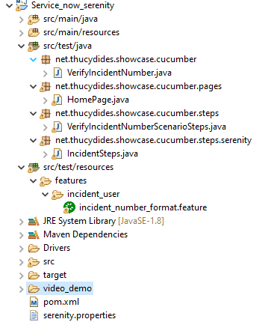
Project Structure (Serenity + Cucumber) For Service Now

Slide 7
Framework Explanation
Page factory – All the Web Elements of different pages are present in different classes in (net.thucydides.showcase.cucumber.pages) package under src/test/java.
Step Definitions – All the steps of feature file are implemented in different classes present in (net.thucydides.showcase.cucumber.steps) package under src/test/java.
Feature File – All the feature files are present in features folder with .feature extension under src/test/resources.
Serenity.properties – This file is present at project root level which contains path to different browsers driver, driver initialization and serenity waits.
Maven – Maven is used as build tool and POM.xml is present at project root level for dependency management.
Target Folder – All serenity reports are generated inside this folder (target/site/serenity) under src/test/resources with .html extensions.
Test Runner class is present in (net.thucydides.showcase.cucumber) package under src/test/java which can be used for execution and providing path to feature files.

Slide 8
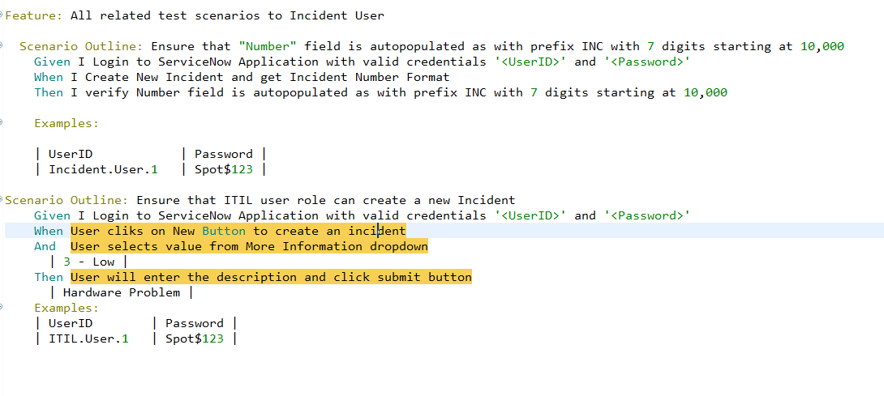
Feature File

Slide 9
How To Run Test Cases
Steps to run at your system:
Clone the repository using "git clone
- 1st way
• Run "mvn install“
OR
• Run "mvn clean verify"
- 2nd way
• Run ‘VerifyIncidentNumber' class as Junit test present in Location:
src\test\java\net\thucydides\showcase\cucumber\VerifyIncidentNumber.java
- Execution of test case is present in video demo folder.

Slide 10
Reporting in Serenity
Serenity itself develops beautiful reports after the execution of all test cases.
No need to write extra code for reporting
It takes screenshot after each method annotated with @Step annotation.
It develops report in pie chart also.

Slide 11
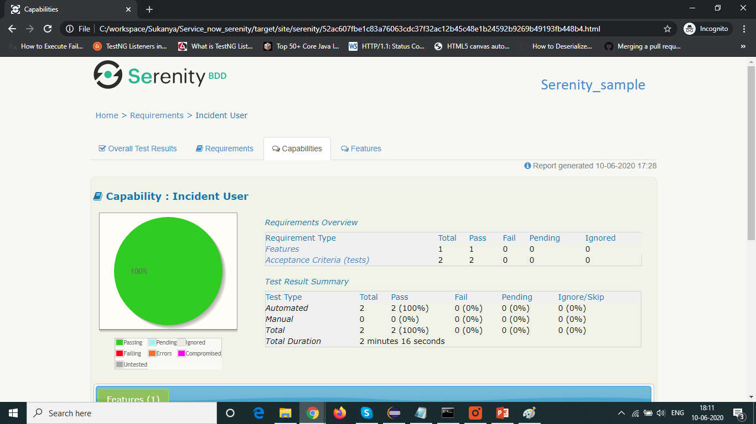
Serenity Report - 1

Slide 12
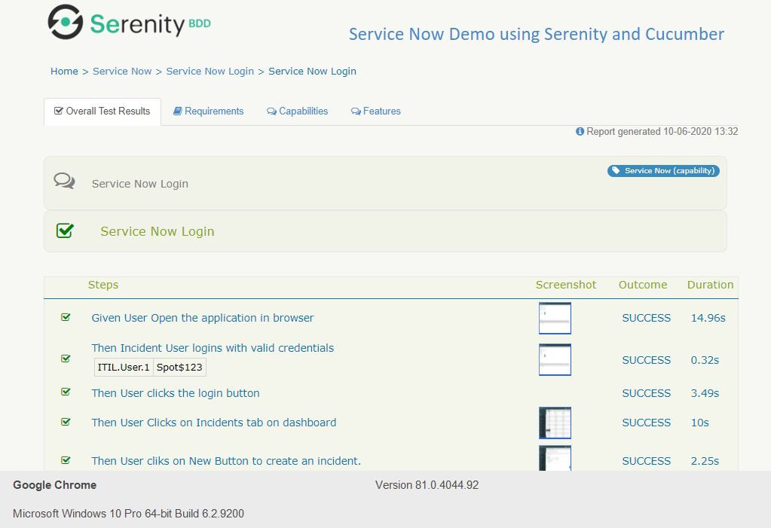
Serenity Report - 2

